Slide 1
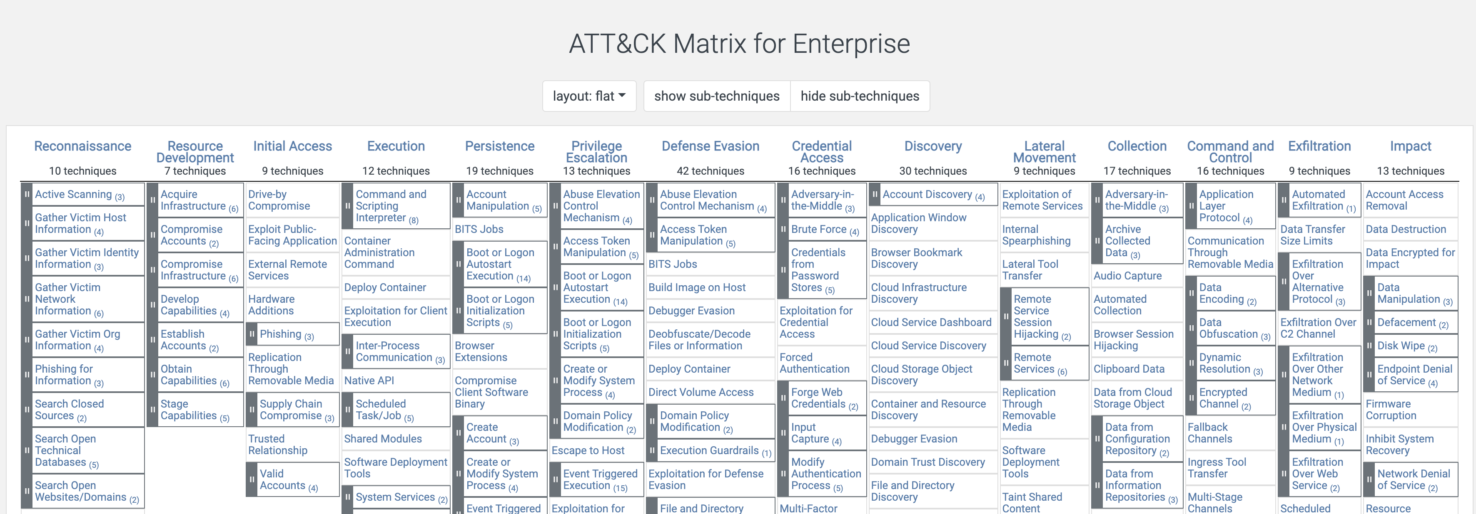
MITRE ATT&CK
https://attack.mitre.org/
Today we will be touching on Discovery.

Slide 2
Discovery

Slide 3

What is the goal of discovery?
Understanding the environment, to plan next steps
I like to say that every attack is an insider attack, once the discovery phase has been completed (they know your environment like it is their own home).
Map out the environment to see what type of opportunities are available.
Discovery of accounts, domain trusts and GPOs.
Discovery of networks and traffic.
Discovery of systems, installed software and possible vulnerabilities.
This Photo by Unknown Author is licensed under CC BY-SA

